Slide 1
SPRING FESTIVAL 2026
HOLIDAY IN
CHIANG MAI
Sun, Jungle & Flavor
HECTOR 6I(26)

Slide 2
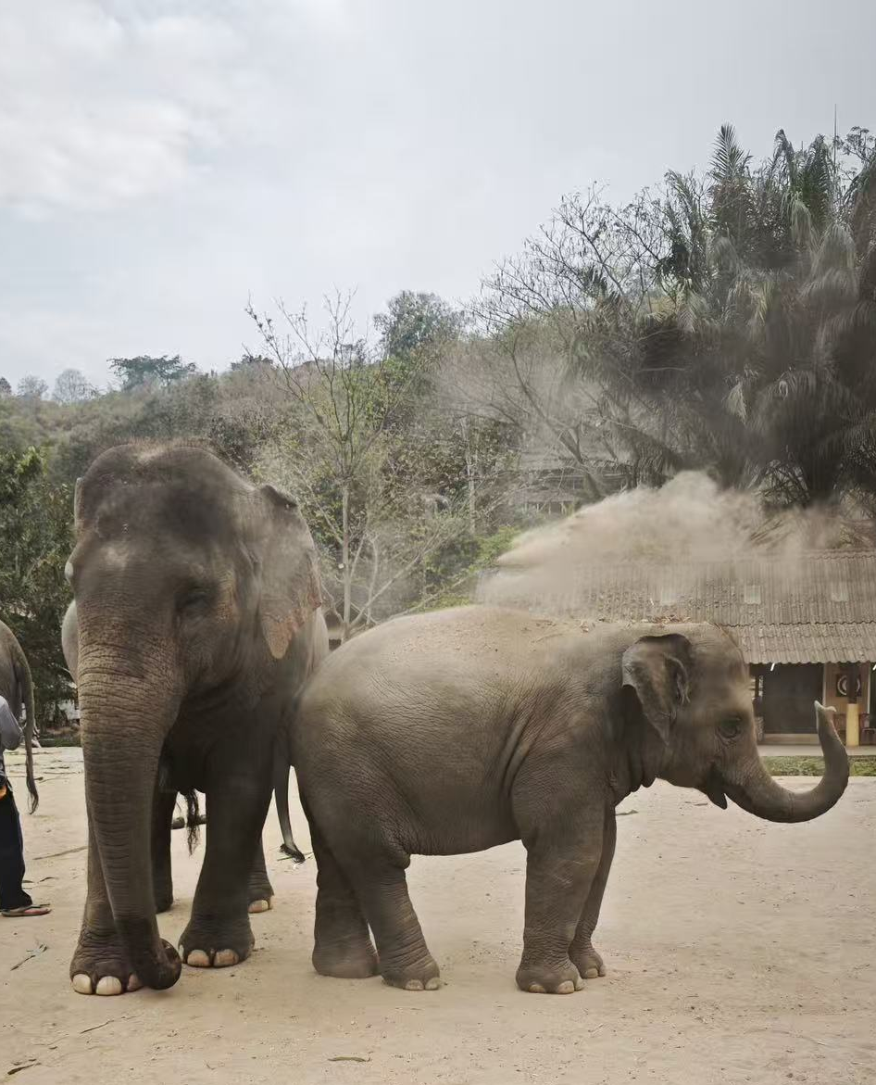
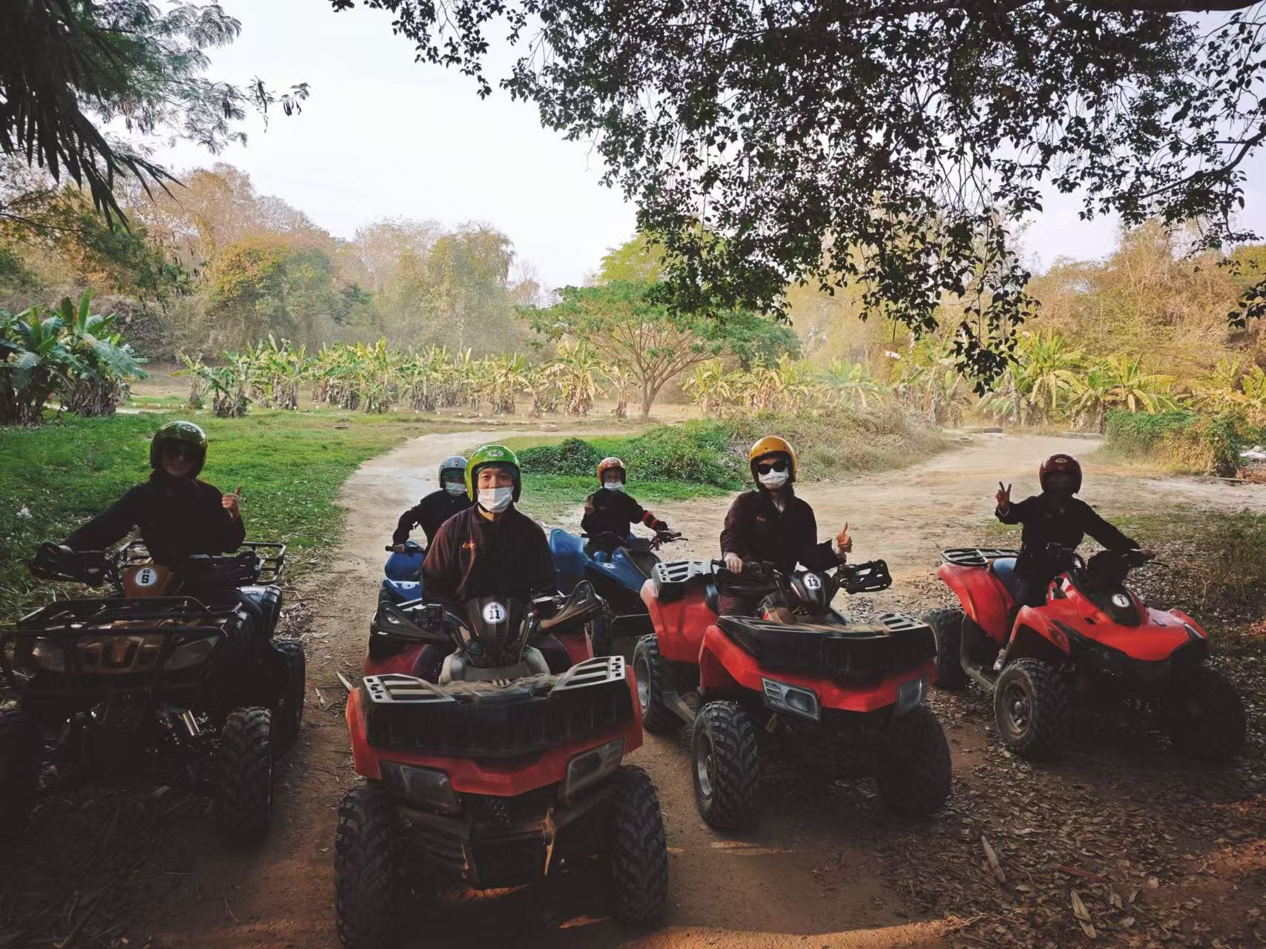
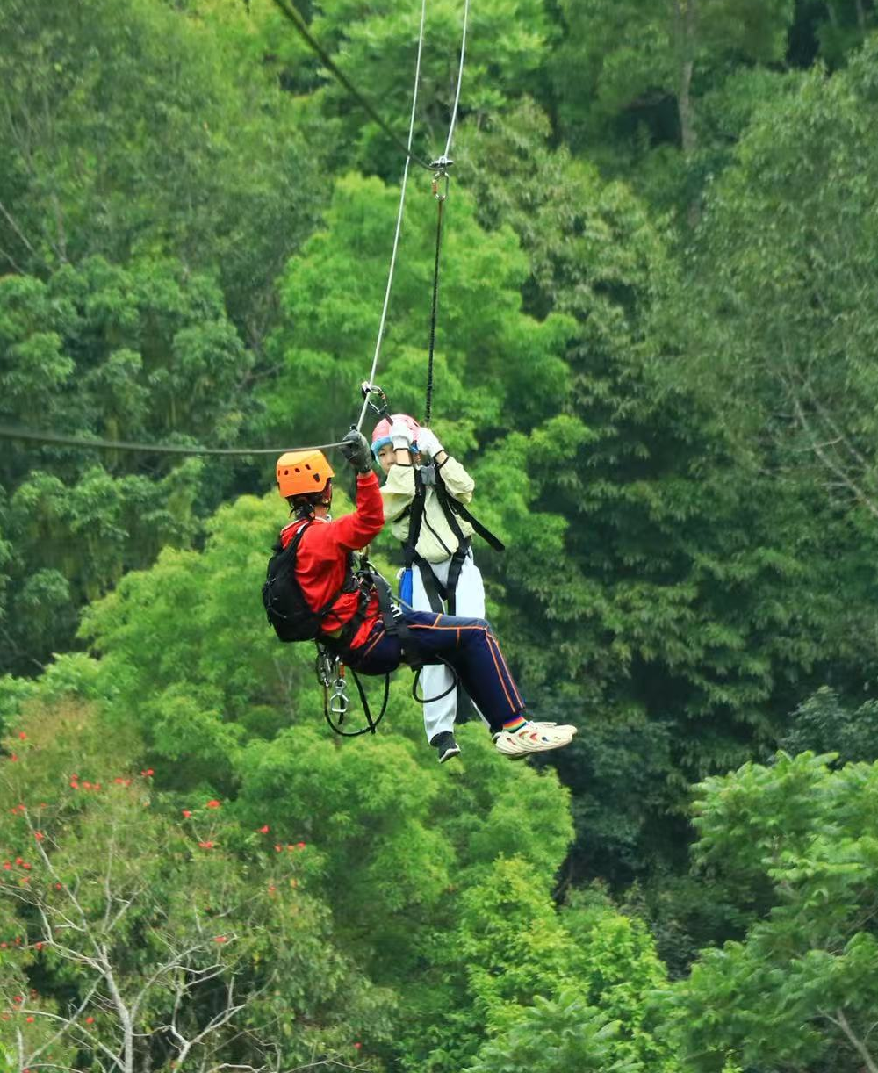
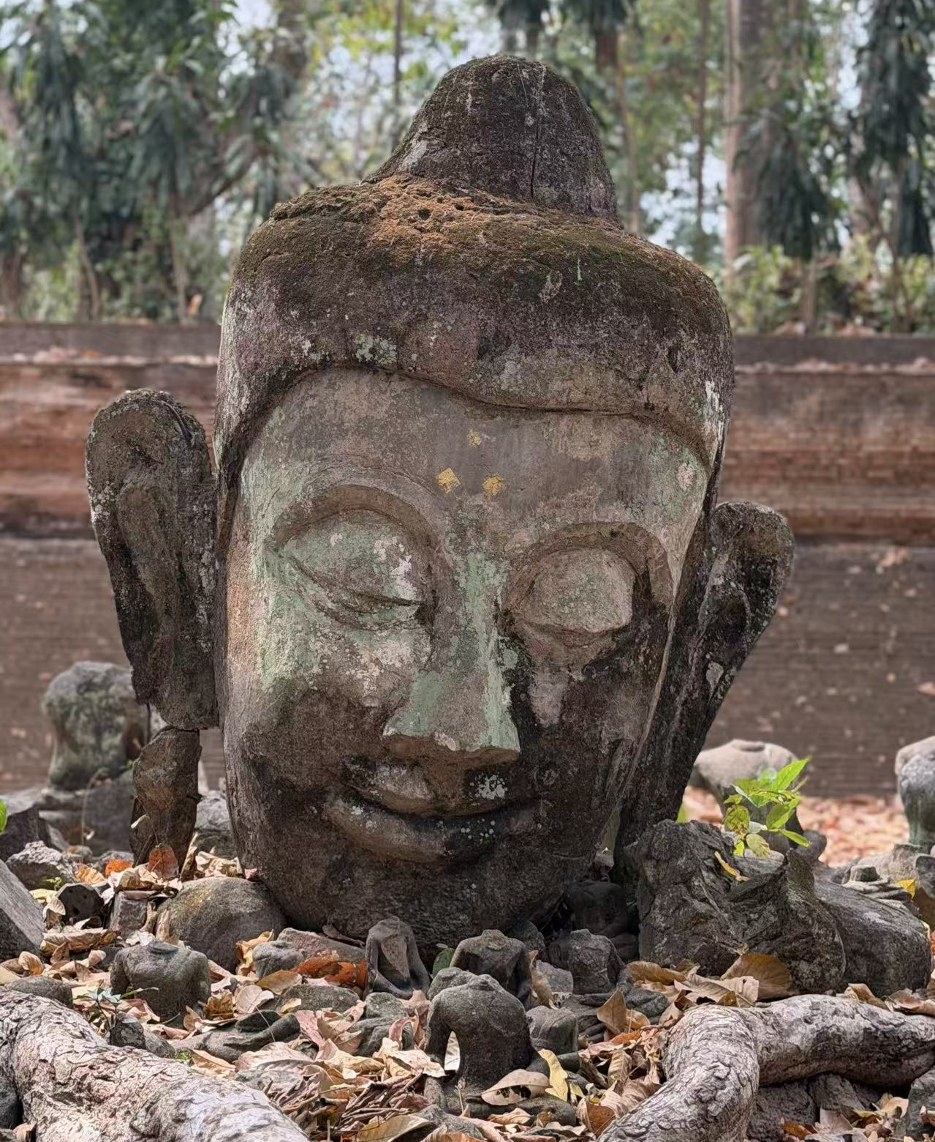
Journey Overview
01
HEART · Elephant Sanctuary
Ethical wildlife encounter with Thailand's gentle giants
02
SPLASH · Sticky Falls & ATV
Waterfall climbing and jungle adventure sports
03
PEAK · Doi Suthep & Art Village
Sacred temple and creative community exploration
04
FLY · Jungle Zipline
Soaring through the rainforest canopy

Slide 3
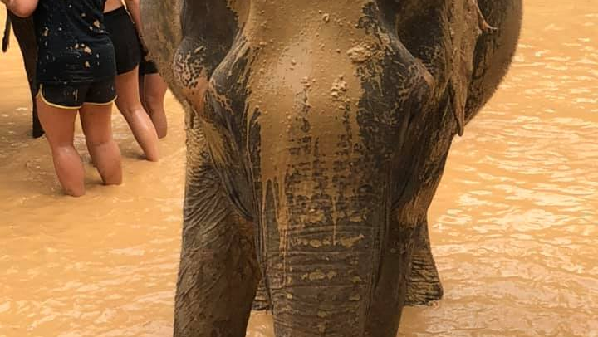
MEETING THE
GENTLE GIANTS
No chains, no riding – just love
Feeding
Mud bath time
An ethical sanctuary experience where respect and care for these magnificent creatures comes first.

Slide 4
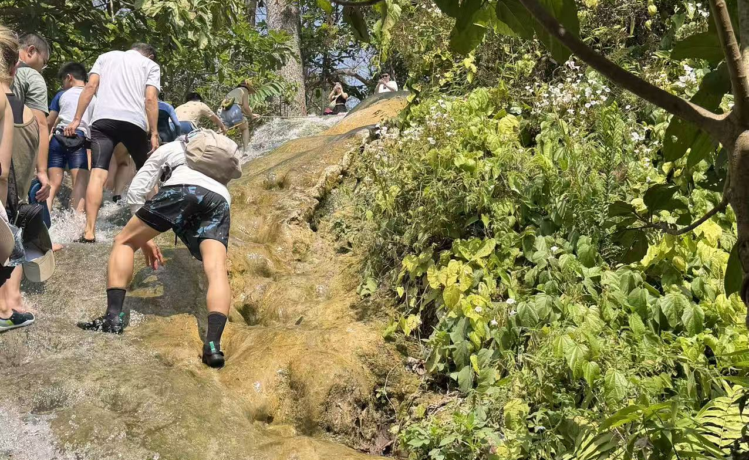
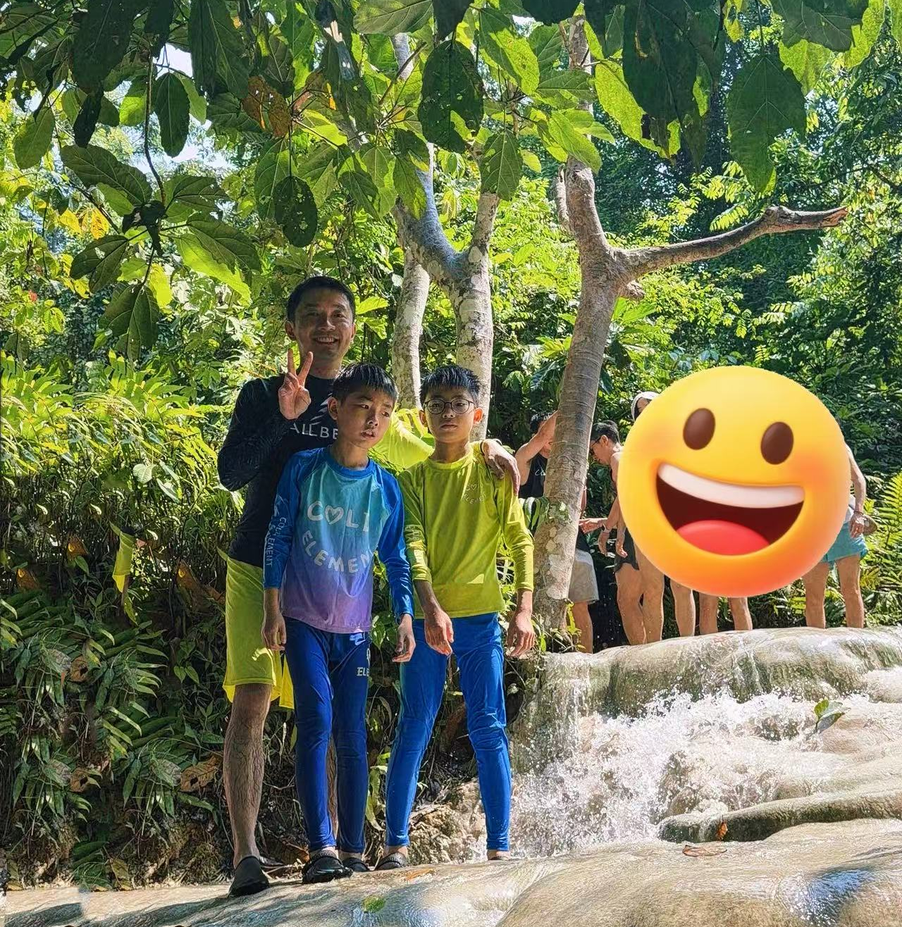
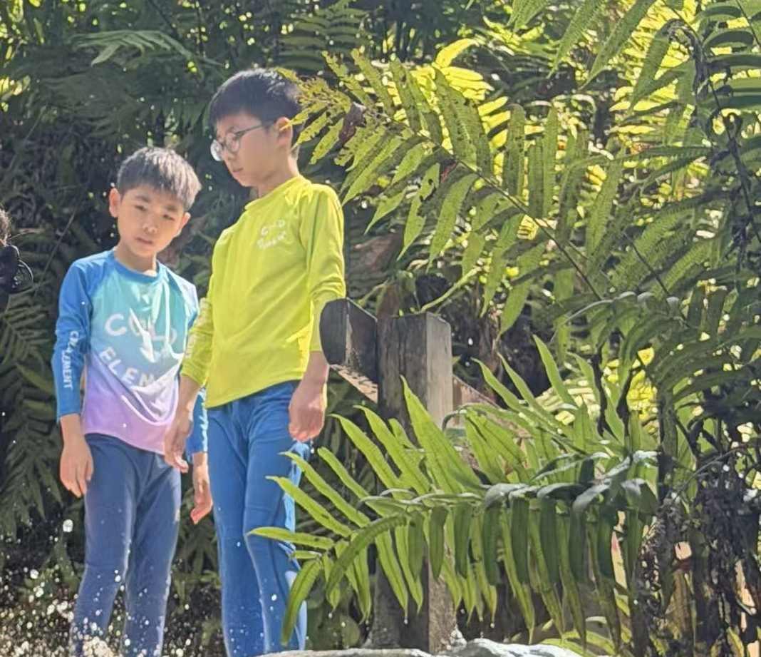
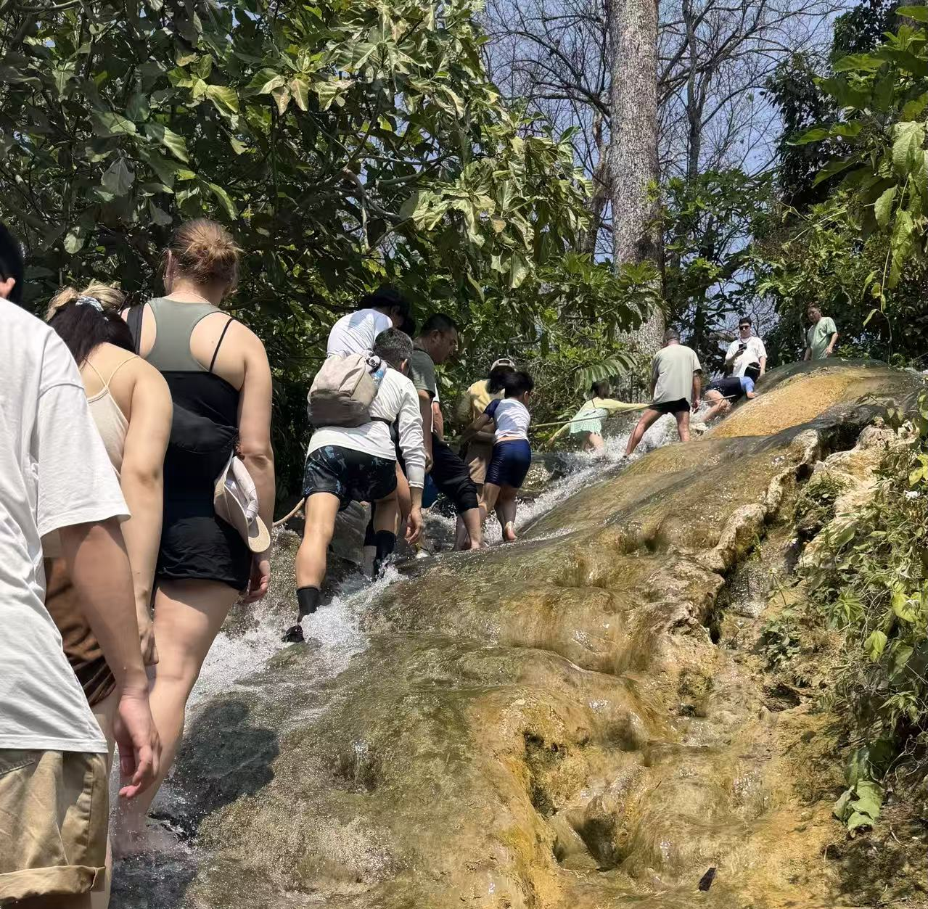
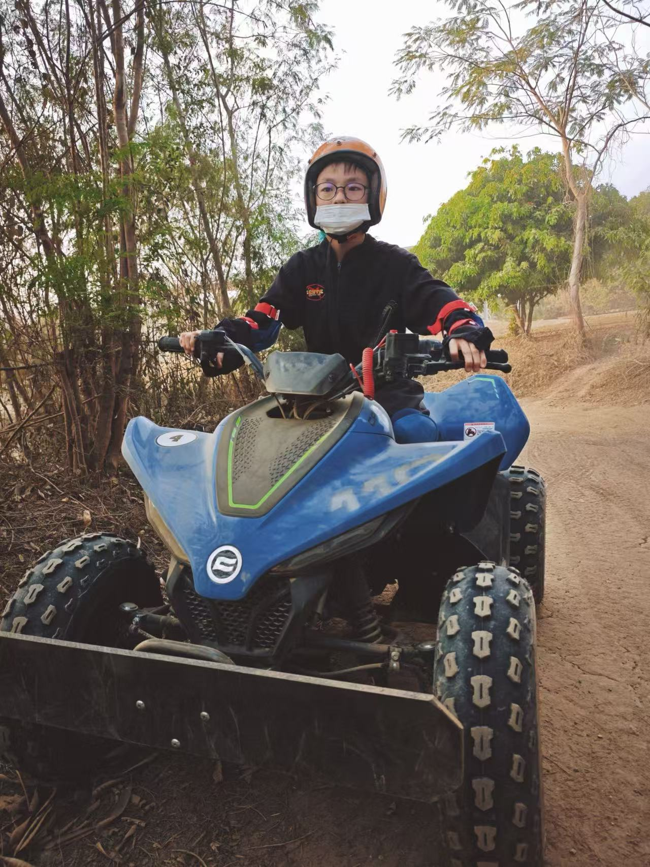
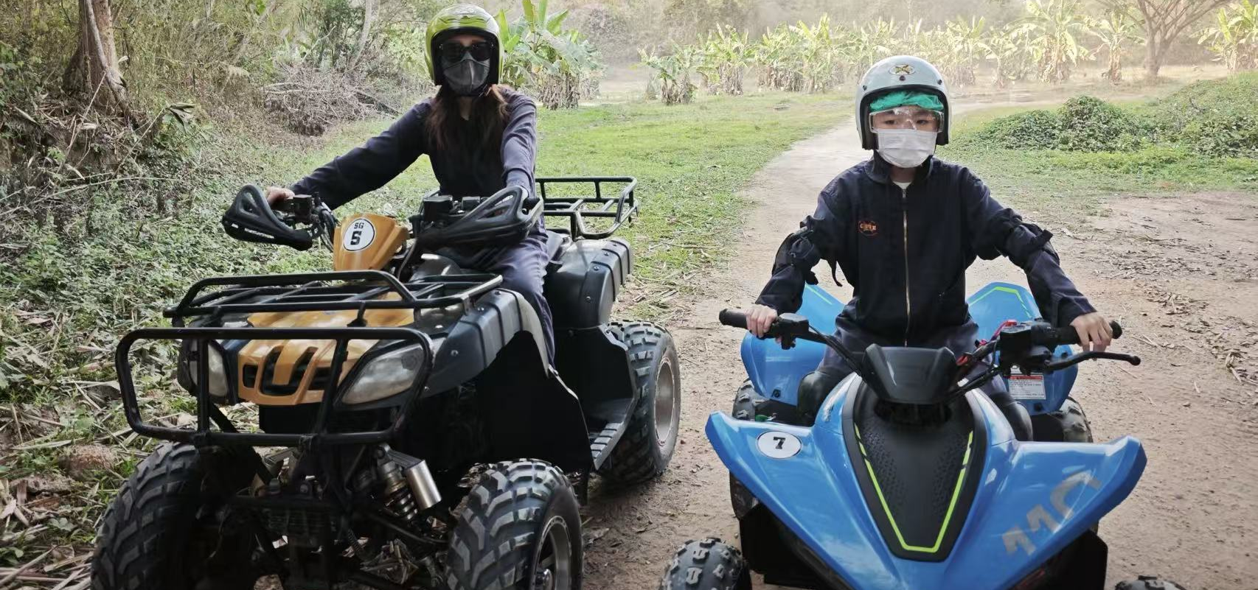
CLIMB & RIDE
The Sticky Waterfall
Climbed the travertine rocks at Bua Thong. The water was cool, and the view was absolutely insane.
ATV Jungle Bash
Got covered in mud, sped through the jungle, and enjoy the off-road adventure.

Slide 5
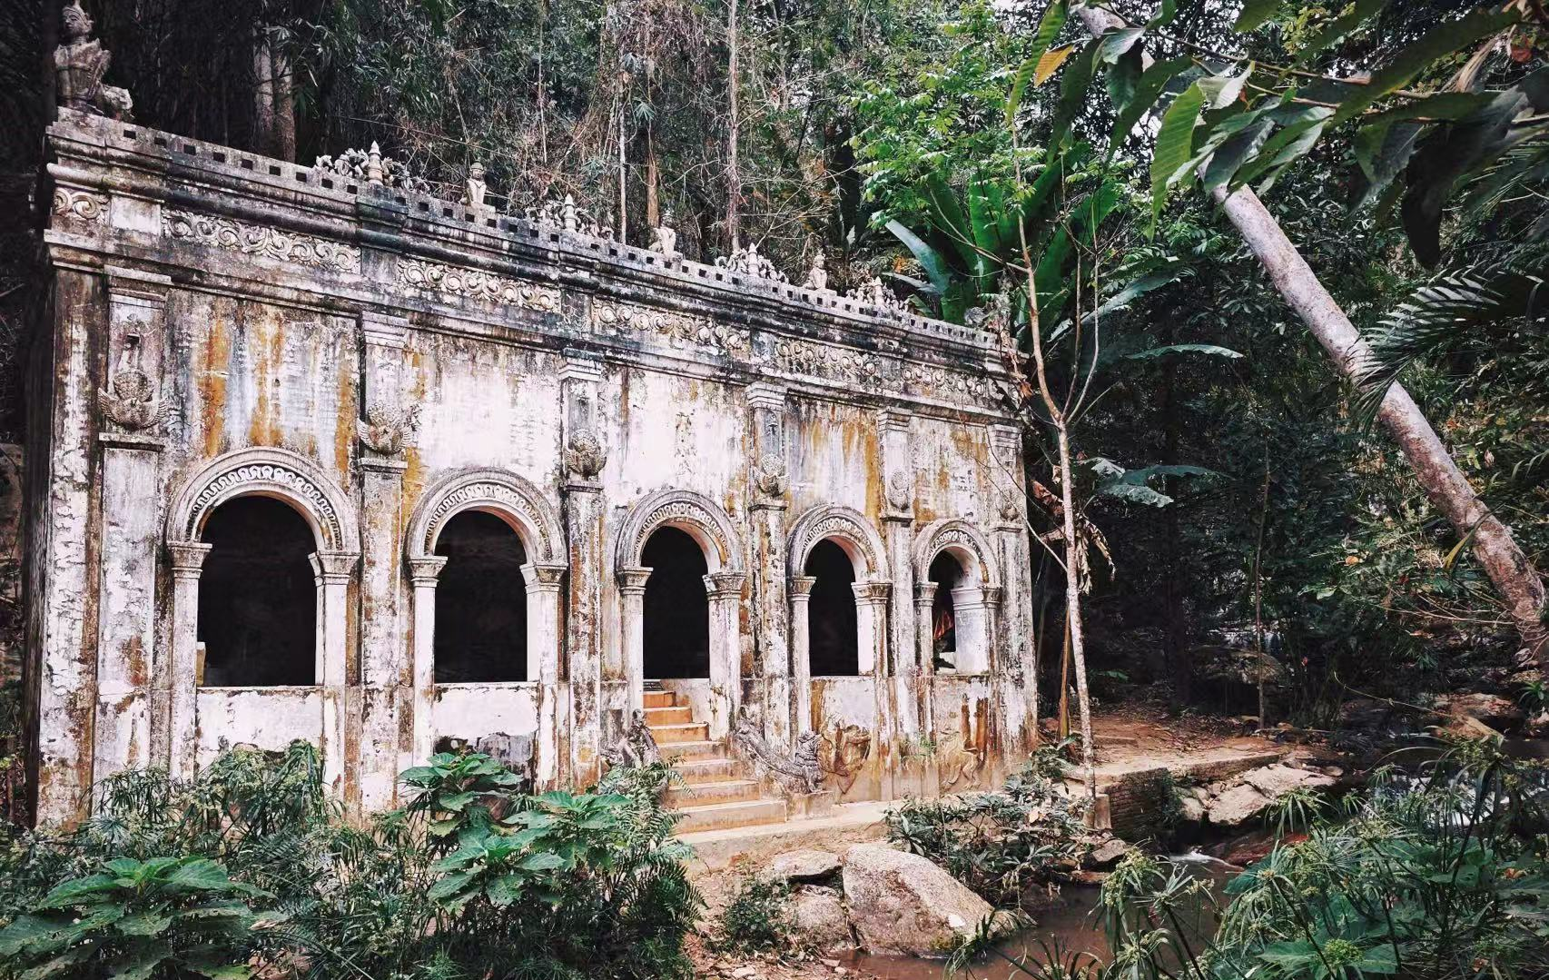
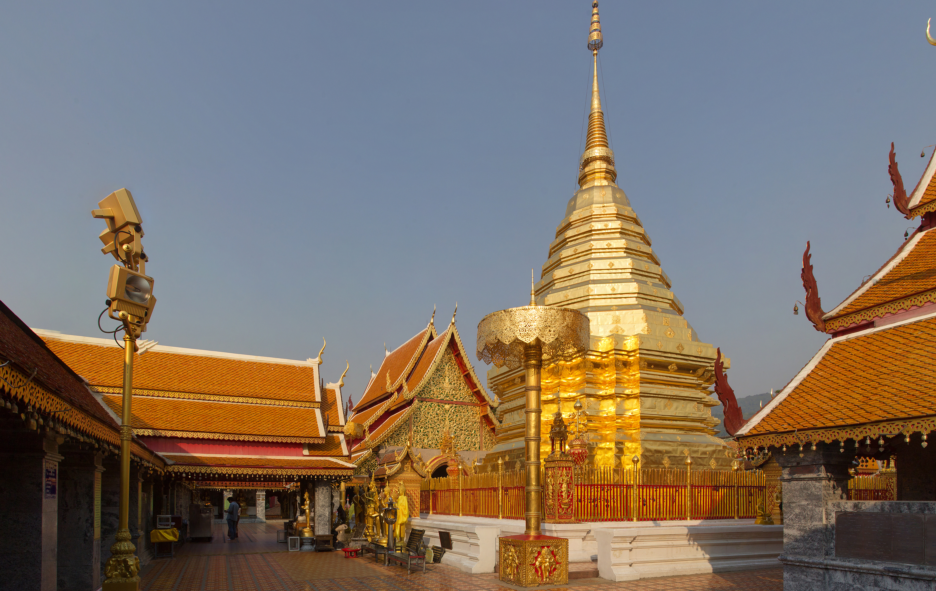
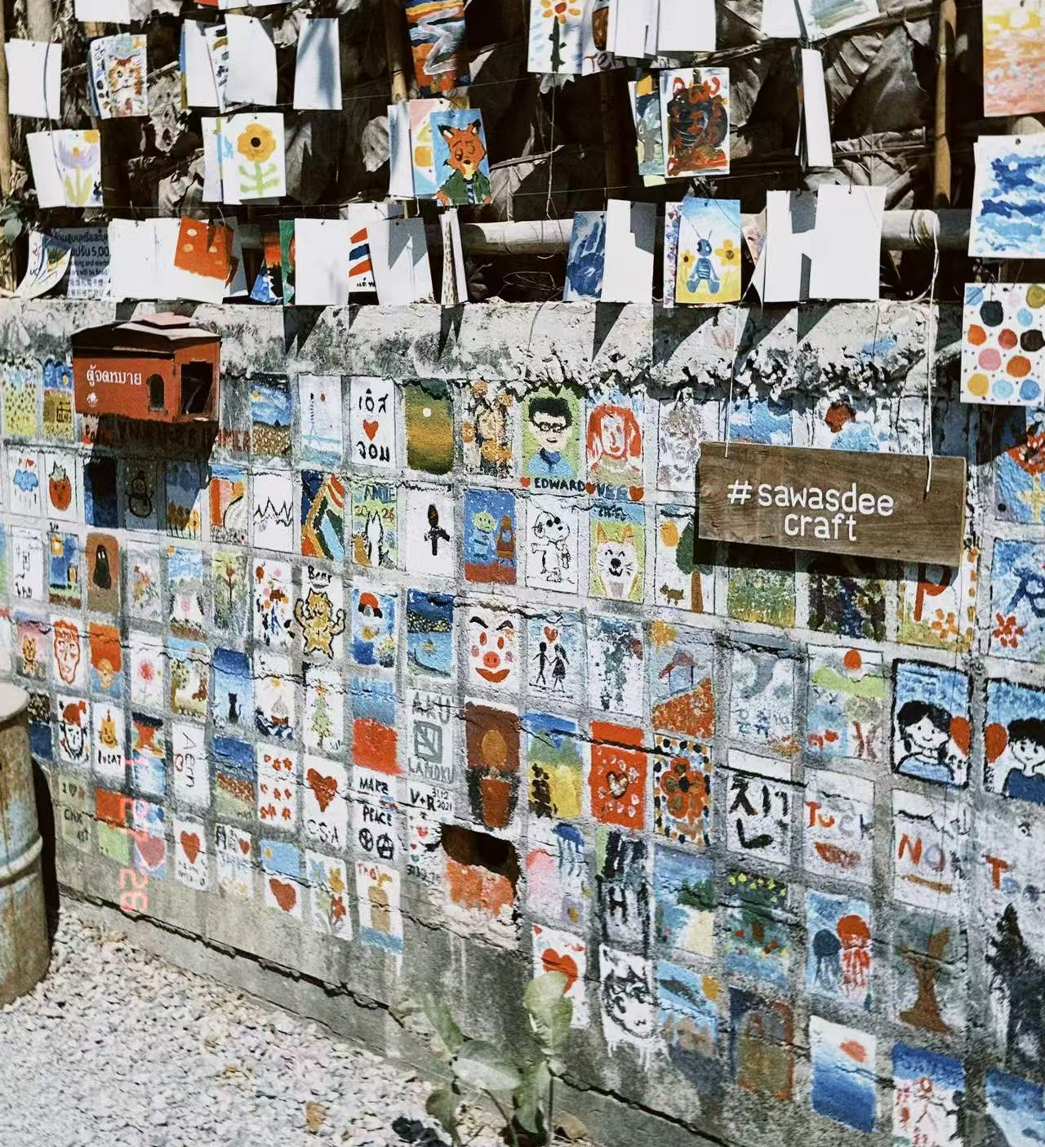
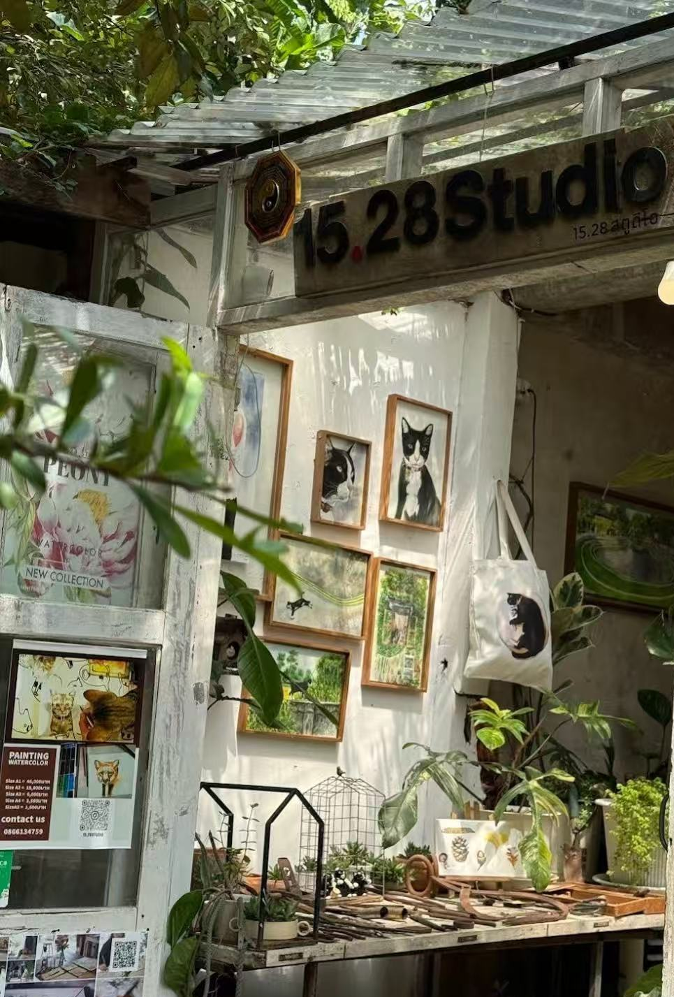
TEMPLE TO TOWN
Doi Suthep
Baan Kang Wat
306 steps to heaven. Golden pagoda shining in the sun. A quiet moment of peace above the city.
Hipster artist village. Handmade pottery. Cold brew coffee. Acoustic guitar in the background.
Wat Pha Lat
Artist Community

Slide 6
FLYING THROUGH
THE CLOUDS
Longest zipline: 1200 meters!
Felt like a bird

Slide 7
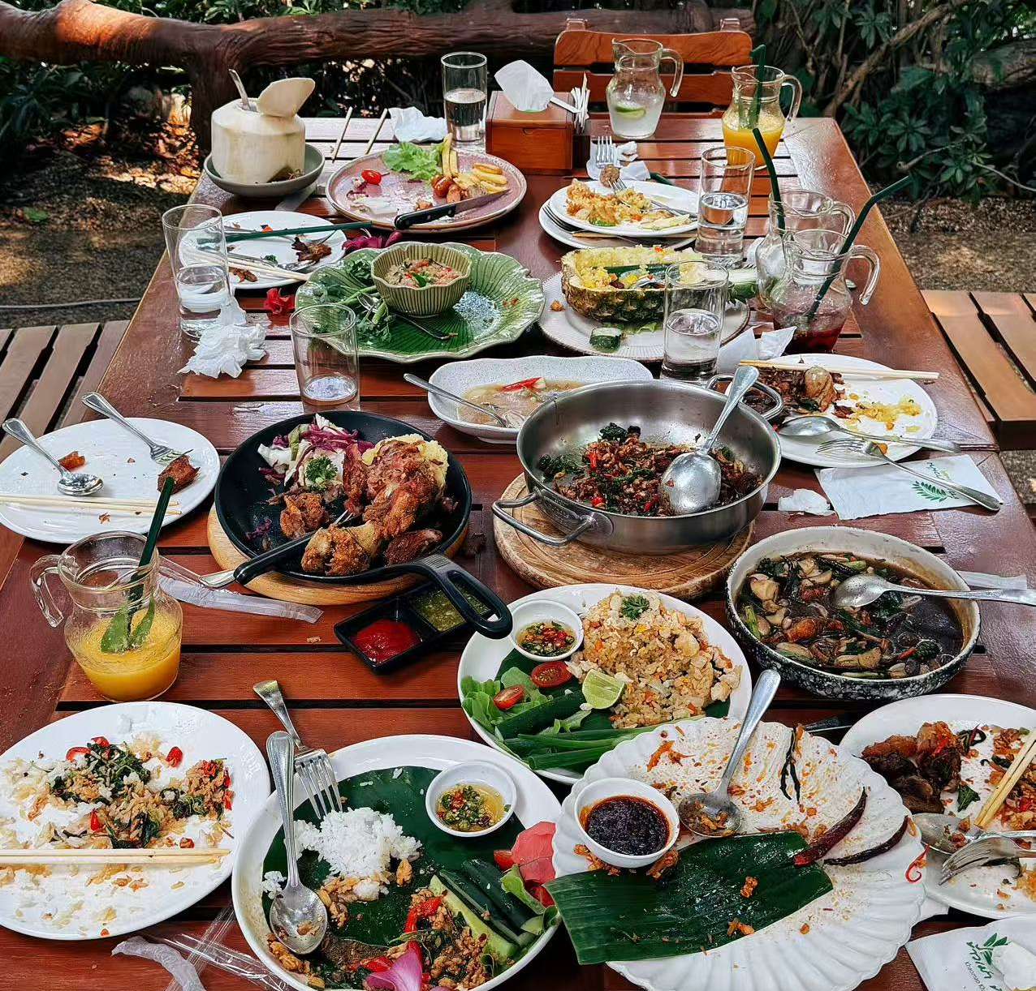
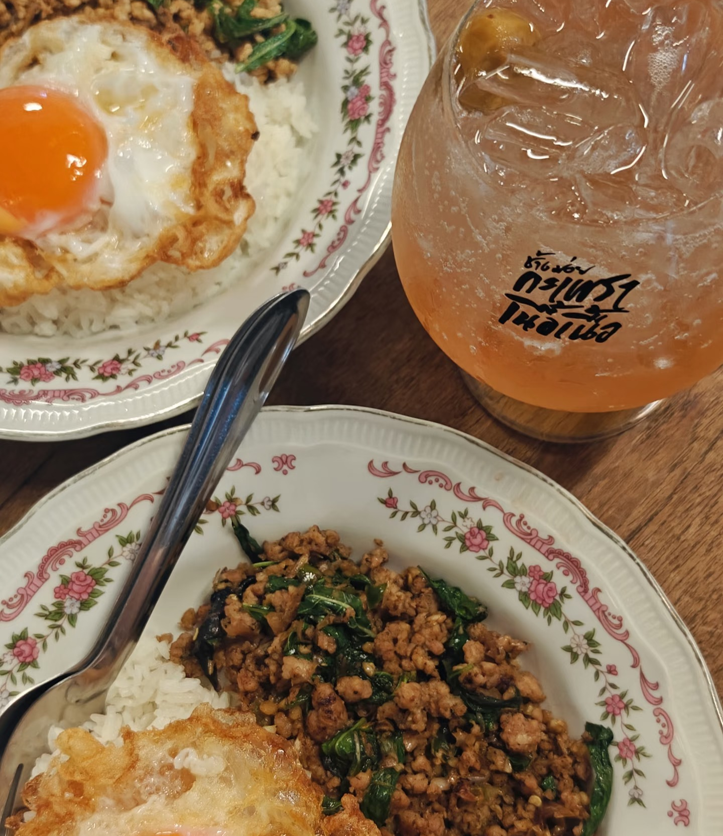
Culinary Journey
THE REAL STAR: THAI FOOD

Slide 8
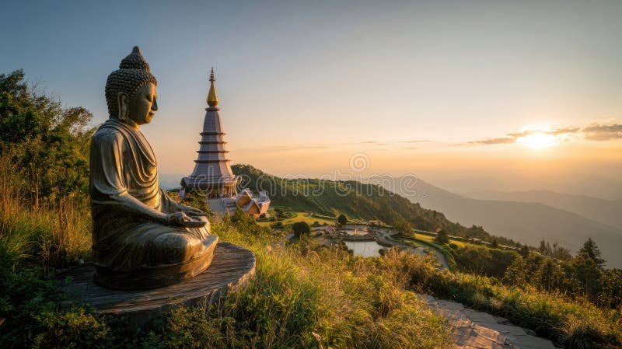
SAWASDEE KHAP
See you next time, Thailand.
Chiang Mai surprised me with its mix of nature and culture
Warm, affordable, and exciting – highly recommended!
THANKS

